Slide 1
Exceptions

Slide 2
The try block lets you test a block of code for errors.
The except block lets you handle the error.
The else block lets you execute code when there is no error.
The finally block lets you execute code, regardless of the result of the try- and except blocks.

Slide 3


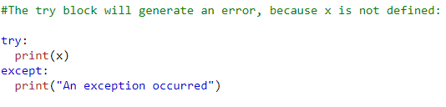


Slide 4
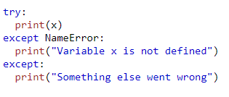


Slide 5
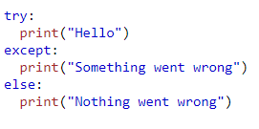


Slide 6
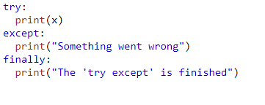


Slide 7
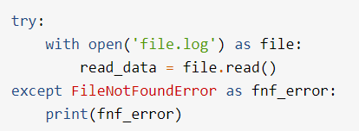

Slide 8
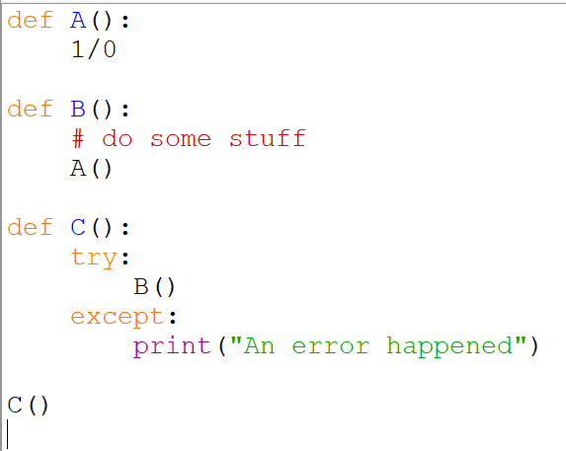

Catching exceptions
try
except

Slide 9
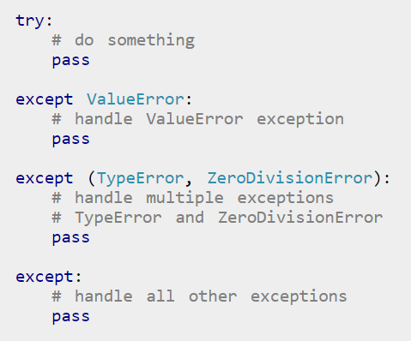
Catching specific exceptions

Slide 10

Raise an exception
As a Python developer you can choose to throw an exception if a condition occurs.
To throw (or raise) an exception, use the raise keyword.
Is this an exceptional circumstance?

Slide 11
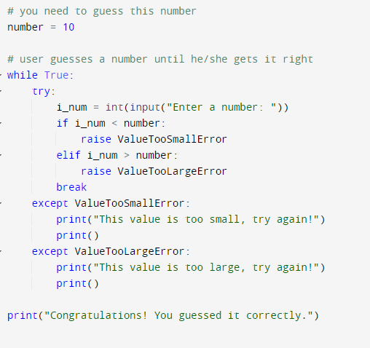
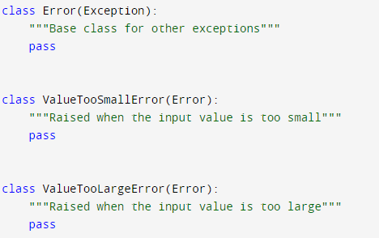
Task 1:
Copy the following code:

Slide 12
Tasks:
Create some code that tests user input. It should be numeric, between 0 and 10. Otherwise raise and appropriate exception
Further reading:
https://realpython.com/the-most-diabolical-python-antipattern/

